Slide 1

Sequence diagrams
Sequence diagrams are part of the UML and are used to model the interactions between the actors and the objects within a system.
A sequence diagram shows the sequence of interactions that take place during a particular use case or use case instance.
The objects and actors involved are listed along the top of the diagram, with a dotted line drawn vertically from these.
Interactions between objects are indicated by annotated arrows.
Chapter 5 System modeling
Notes:
Annotate：注解

Slide 2
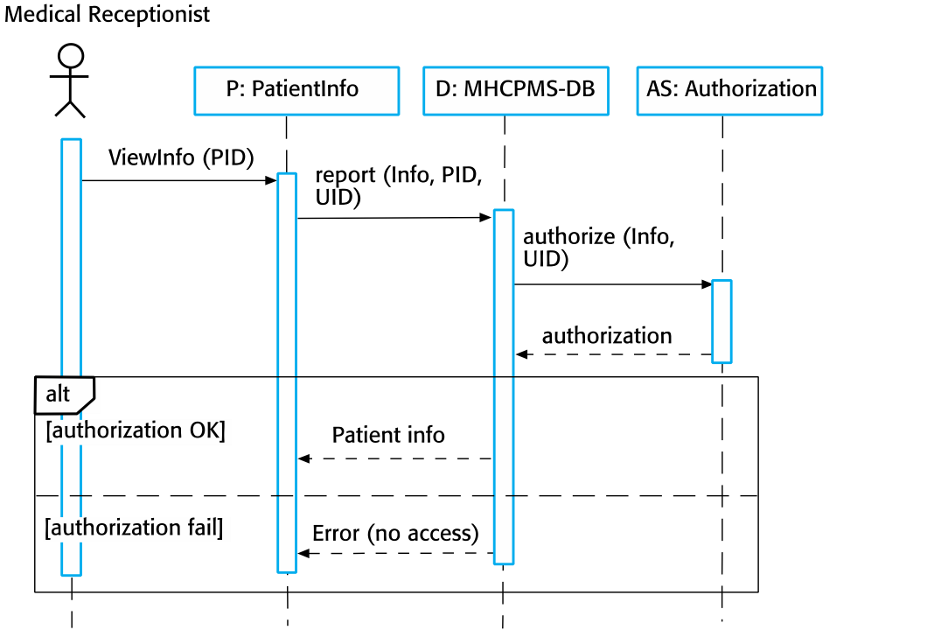
Sequence diagram for View patient information
Chapter 5 System modeling

Slide 3
Sequence diagram for Transfer Data
Chapter 5 System modeling

Slide 4
Structural models
Structural models of software display the organization of a system in terms of the components that make up that system and their relationships.
Structural models may be static models, which show the structure of the system design, or dynamic models, which show the organization of the system when it is executing.
You create structural models of a system when you are discussing and designing the system architecture.
Chapter 5 System modeling

Slide 5
Class diagrams
Class diagrams are used when developing an object-oriented system model to show the classes in a system and the associations between these classes.
An object class can be thought of as a general definition of one kind of system object.
An association is a link between classes that indicates that there is some relationship between these classes.
When you are developing models during the early stages of the software engineering process, objects represent something in the real world, such as a patient, a prescription, doctor, etc.
Chapter 5 System modeling

Slide 6

UML classes and association
Chapter 5 System modeling

Slide 7
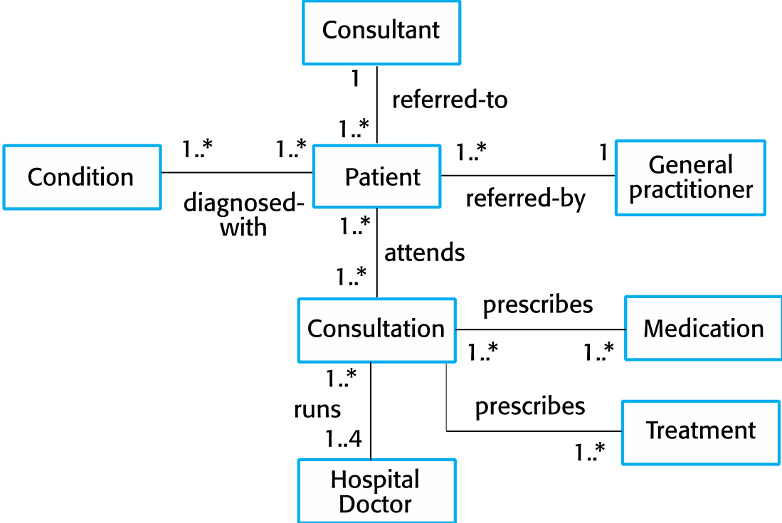
Classes and associations in the MHC-PMS
Chapter 5 System modeling
Notes:
Condition：健康状况
Consultant：医生
Consultation：会诊
Practitioner：执业医生

Slide 8
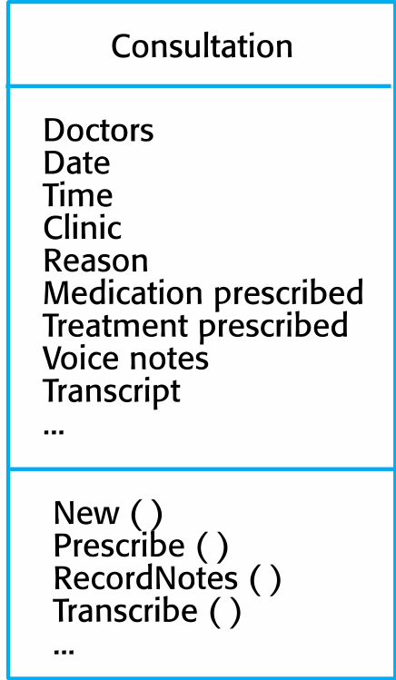
The Consultation class
Chapter 5 System modeling

Slide 9
Generalization
Generalization is an everyday technique that we use to manage complexity.
Rather than learn the detailed characteristics of every entity that we experience, we place these entities in more general classes (animals, cars, houses, etc.) and learn the characteristics of these classes.
This allows us to infer that different members of these classes have some common characteristics.
Chapter 5 System modeling

Slide 10
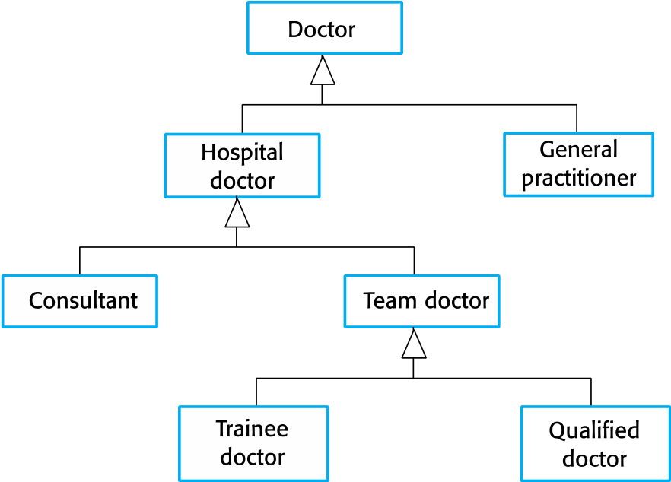
A generalization hierarchy
Chapter 5 System modeling

Slide 11
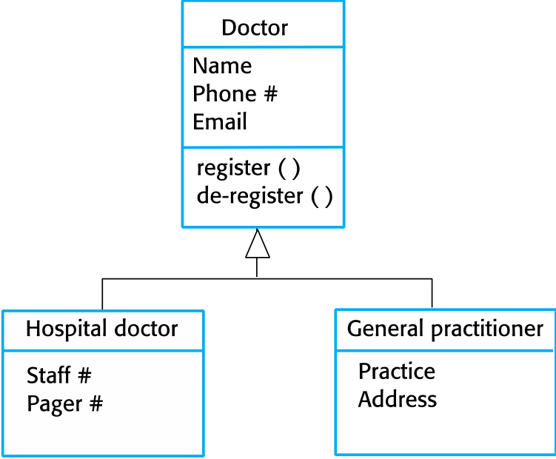
A generalization hierarchy with added detail
Chapter 5 System modeling

Slide 12
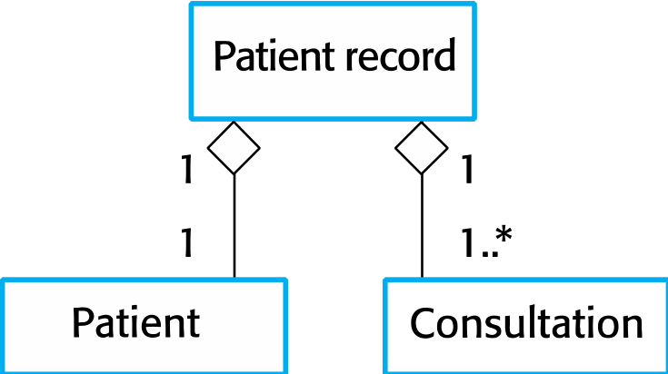
Object class aggregation models
An aggregation model shows how classes that are collections are composed of other classes.
Aggregation models are similar to the part-of relationship in semantic data models.
Chapter 5 System modeling

Slide 13
Behavioral models
Behavioral models are models of the dynamic behavior of a system as it is executing. They show what happens or what is supposed to happen when a system responds to a stimulus from its environment.
You can think of these stimuli as being of two types:
Data Some data arrives that has to be processed by the system.
Events Some event happens that triggers system processing. Events may have associated data, although this is not always the case.
Chapter 5 System modeling

Slide 14
Data-driven modeling
Many business systems are data-processing systems that are primarily driven by data. They are controlled by the data input to the system, with relatively little external event processing.
Data-driven models show the sequence of actions involved in processing input data and generating an associated output.
They are particularly useful during the analysis of requirements as they can be used to show end-to-end processing in a system.
Chapter 5 System modeling

Slide 15
An activity model of the insulin pump’s operation
Chapter 5 System modeling

Slide 16
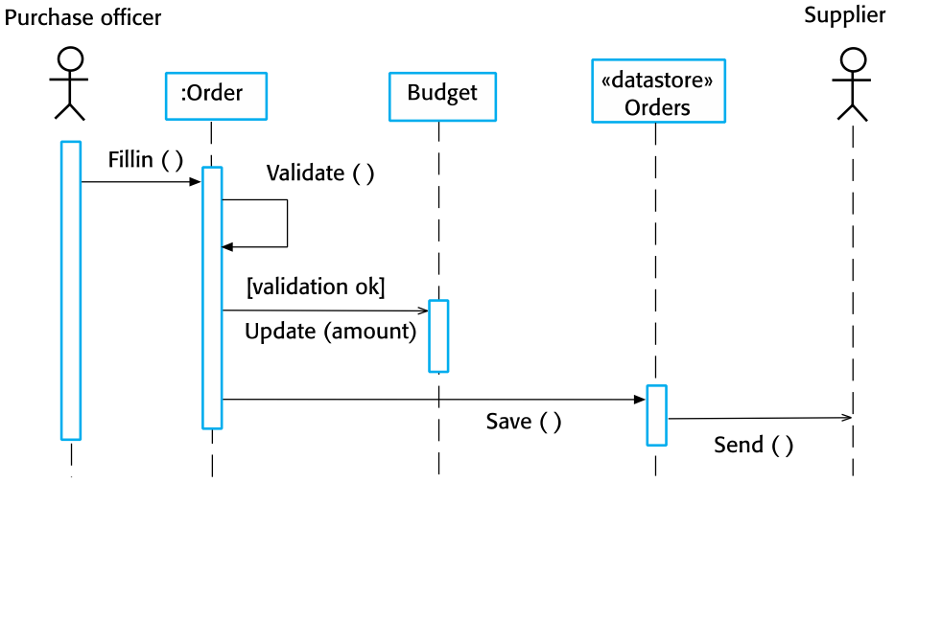
Order processing
Chapter 5 System modeling

Slide 17
Event-driven modeling
Real-time systems are often event-driven, with minimal data processing. For example, a landline phone switching system responds to events such as ‘receiver off hook’ by generating a dial tone.
Event-driven modeling shows how a system responds to external and internal events.
It is based on the assumption that a system has a finite number of states and that events (stimuli) may cause a transition from one state to another.
Chapter 5 System modeling

Slide 18
State machine models
These model the behaviour of the system in response to external and internal events.
They show the system’s responses to stimuli so are often used for modelling real-time systems.
State machine models show system states as nodes and events as arcs between these nodes. When an event occurs, the system moves from one state to another.
Statecharts are an integral part of the UML and are used to represent state machine models.
Chapter 5 System modeling

Slide 19
State diagram of a microwave oven
Chapter 5 System modeling

Slide 20
States and stimuli for the microwave oven (a)
State | Description
Waiting | The oven is waiting for input. The display shows the current time.
Half power | The oven power is set to 300 watts. The display shows ‘Half power’.
Full power | The oven power is set to 600 watts. The display shows ‘Full power’.
Set time | The cooking time is set to the user’s input value. The display shows the cooking time selected and is updated as the time is set.
Disabled | Oven operation is disabled for safety. Interior oven light is on. Display shows ‘Not ready’.
Enabled | Oven operation is enabled. Interior oven light is off. Display shows ‘Ready to cook’.
Operation | Oven in operation. Interior oven light is on. Display shows the timer countdown. On completion of cooking, the buzzer is sounded for five seconds. Oven light is on. Display shows ‘Cooking complete’ while buzzer is sounding.
Chapter 5 System modeling

Slide 21
States and stimuli for the microwave oven (b)
Stimulus | Description
Half power | The user has pressed the half-power button.
Full power | The user has pressed the full-power button.
Timer | The user has pressed one of the timer buttons.
Number | The user has pressed a numeric key.
Door open | The oven door switch is not closed.
Door closed | The oven door switch is closed.
Start | The user has pressed the Start button.
Cancel | The user has pressed the Cancel button.
Chapter 5 System modeling

Slide 22
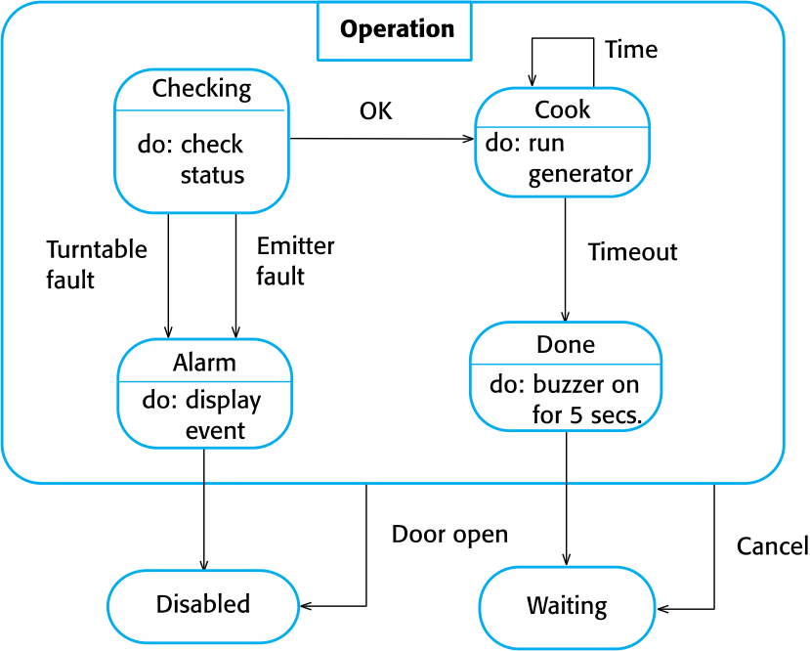
Microwave oven operation
Chapter 5 System modeling

Slide 23
Model driven architecture
Model-driven architecture (MDA) was the precursor of more general model-driven engineering
MDA is a model-focused approach to software design and implementation that uses a subset of UML models to describe a system.
Models at different levels of abstraction are created. From a high-level, platform independent model, it is possible, in principle, to generate a working program without manual intervention.
Chapter 5 System modeling
Notes:
Precursor:先锋

Slide 24
Types of model
A computation independent model (CIM)
These model the important domain abstractions used in a system. CIMs are sometimes called domain models.
A platform independent model (PIM)
These model the operation of the system without reference to its implementation. The PIM is usually described using UML models that show the static system structure and how it responds to external and internal events.
Platform specific models (PSM)
These are transformations of the platform-independent model with a separate PSM for each application platform. In principle, there may be layers of PSM, with each layer adding some platform-specific detail.
Chapter 5 System modeling

Slide 25
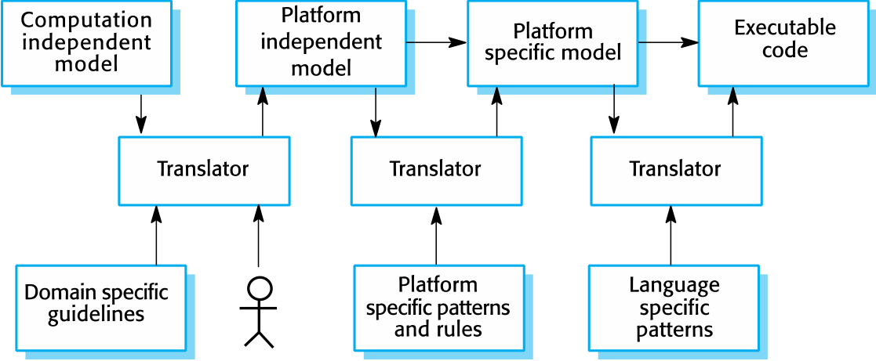
MDA transformations
Chapter 5 System modeling

Slide 26
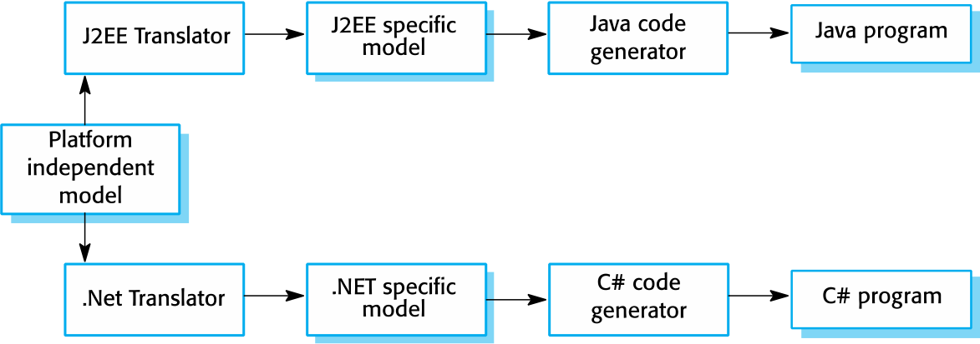
Multiple platform-specific models
Chapter 5 System modeling

Slide 27
Agile methods and MDA
The developers of MDA claim that it is intended to support an iterative approach to development and so can be used within agile methods.
The notion of extensive up-front modeling contradicts the fundamental ideas in the agile manifesto and I suspect that few agile developers feel comfortable with model-driven engineering.
If transformations can be completely automated and a complete program generated from a PIM, then, in principle, MDA could be used in an agile development process as no separate coding would be required.
Chapter 5 System modeling

Slide 28
Executable UML
The fundamental notion behind model-driven engineering is that completely automated transformation of models to code should be possible.
This is possible using a subset of UML 2, called Executable UML or xUML.
Chapter 5 System modeling

Slide 29
Features of executable UML
To create an executable subset of UML, the number of model types has therefore been dramatically reduced to these 3 key types:
Domain models that identify the principal concerns in a system. They are defined using UML class diagrams and include objects, attributes and associations.
Class models in which classes are defined, along with their attributes and operations.
State models in which a state diagram is associated with each class and is used to describe the life cycle of the class.
The dynamic behavior of the system may be specified declaratively using the object constraint language (OCL), or may be expressed using UML’s action language.
Chapter 5 System modeling

Slide 30
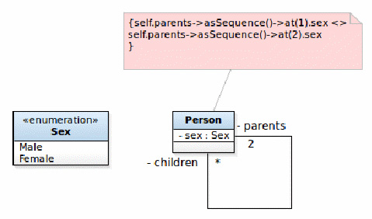
带有 OCL 约束的系谱树形模型
OCL指定两个父类拥有不同的属性：
{ self.parents->asSequence()->at(1).sex <> self.parents->asSequence()->at(2).sex }

Slide 31
Key points
A model is an abstract view of a system that ignores system details. Complementary system models can be developed to show the system’s context, interactions, structure and behavior.
Context models show how a system that is being modeled is positioned in an environment with other systems and processes.
Use case diagrams and sequence diagrams are used to describe the interactions between users and systems in the system being designed. Use cases describe interactions between a system and external actors; sequence diagrams add more information to these by showing interactions between system objects.
Structural models show the organization and architecture of a system. Class diagrams are used to define the static structure of classes in a system and their associations.
Chapter 5 System modeling

Slide 32
Key points
Behavioral models are used to describe the dynamic behavior of an executing system. This behavior can be modeled from the perspective of the data processed by the system, or by the events that stimulate responses from a system.
Activity diagrams may be used to model the processing of data, where each activity represents one process step.
State diagrams are used to model a system’s behavior in response to internal or external events.
Model-driven engineering is an approach to software development in which a system is represented as a set of models that can be automatically transformed to executable code.
Chapter 5 System modeling

